Slide 1

The meaning of different environments
iTechArt’s internal applications

Slide 2
Types of different environments
DEV (Development)
QA (Quality Assurance)
STG (Staging)
UAT (User Acceptance Testing)
DEMO
PROD (Production)
HOTFIX (Hotfixes of Production)

Slide 3
Why do developers need a DEV environment?
The purpose of a development environment is to have a place for a developer to test anything they want without worrying about it affecting any end-users or content editors working on a live website. In most cases, a development environment is set up on a local machine or server.
Why do QA engineers need a QA environment?
It’s a tester’s playground to go and do all the amazing testing and explore how the product actually works and meets client requirements. QA environments are often mentioned as “sandboxes”. When it comes to testing, testers don’t just test the product but also put the user’s hat on. That means having a dedicated environment, mimicking the clients to perform testing would avoid any critical bugs from being released.

Slide 4
Why does the team need a STG environment?
Before the product is deployed to production, it needs to be properly tested in a pre-production environment, more commonly known as the Staging environment. A staging is not as stable as the production because features and bug fixes are still under testing on staging yet. The primary purpose of this environment is to ensure that the software has been tested enough to be deployed in a production or UAT environment. The staging server is also used for executing performance and load testing.
Why does the team need a UAT environment?
This is where QA engineers perform proper testing and ensure that the application is working according to the stakeholders' expectations. Software running on UAT must ensure that it is a viable product and ready for users. A UAT environment is similar to staging in terms of testing. Like staging, it is used primarily for testing bug fixes and new features. However, unlike Staging, the customer or product owner performs testing in this environment. After the software is approved on UAT, it's deployed to production.

Slide 5
Why does the team need a DEMO environment?
In your demos, how often do you find you are apologizing for an inability to demonstrate capabilities, complete workflows, or present compelling results and reports? Far too often, in many cases! A perfect demo environment enables you to show what you need to show, clearly and convincingly. No apologies, no excuses. This environment often teaches users new features of the application.
Why does the team need a HOTFIX environment?
A hotfix refers to rapid remediation of a defect. When a hotfix occurs, the organization compiles the bug details, then developers and testers discuss a plan for a fast code-and-test routine. Other work stops until the hotfix is coded, tested and deployed. Testing within a live Production server carries significant risk, which is why hotfix testing is often only done up to the Staging or Hotfix.

Slide 6
Back to our internal apps

Slide 7
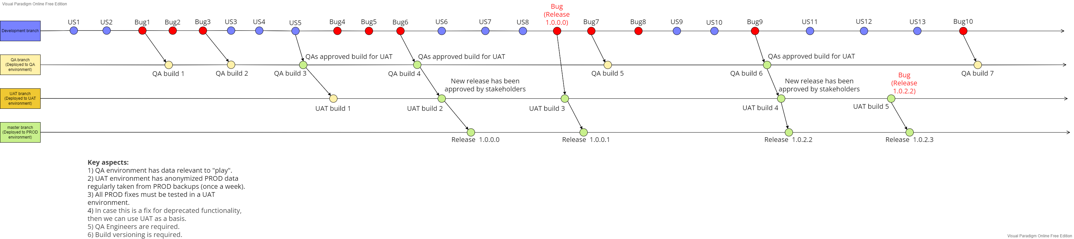

Slide 8
The value of the UAT environment in our conditions.
Be able to conduct User Acceptance Testing (UAT) before each release.
Be able to demonstrate new features to key stakeholders of the project(s).
Be able to test hotfixes for the Production.

Slide 9
How it will be implemented?
Databases should be automatically taken from 'PROD' backups once a week. They can be found in 'internalappsbackupblob' ('expenses-prod' container). Data should be modified to have corresponding links to the attachments updated in​ 'StorageServiceProd' database .
‘internalappsblobuat’ should have a modified copy of ’internalappsblob’ once a week. In ’internalappsblob’ blob files are encrypted by the key stored in 'StorageServiceUat' database. To have working 'UAT' solution, we need to get a list of file attachments from the ‘internalappblob’ and instead of copying to the ‘internalappsblobuat’ we need to create ‘empty’ encrypted files. Logically, we only need to create missing files each time we run an action.

